Slide 1



01AI0506 - Design and Analysis of Algorithms
Unit – 4
Greedy Method & Graph Algorithms
Prepared by
Prof. Abhishek Chauhan
CSE- AI, ML & DS Department

Slide 2


Outline
General Characteristics of greedy algorithms,
Elements of greedy strategy,
Problem solving using,
Activity selection problem
Fractional Knapsack Problem
Job Scheduling Problem
Huffman Code
Representations of graphs - Graph traversal: DFS – BFS -applications – Connectivity
Minimum spanning tree - Kruskal’s and Prim’s algorithms,
Shortest path Algorithms - Dijkstra’s algorithm, Floyd - Warshall algorithm

Slide 3
Greedy Approach/Method - Introduction
A Greedy algorithm is an approach to solving a problem that selects the most appropriate option based on the current situation.
This algorithm ignores the fact that the current best result may not bring about the overall optimal result. Even if the initial decision was incorrect, the algorithm never reverses it.
This simple, intuitive algorithm can be applied to solve any optimization problem which requires the maximum or minimum optimum result.
The best thing about this algorithm is that it is easy to understand and implement.

Slide 4

Limitations of Greedy Approach
Factors listed below :
The greedy algorithm makes judgments based on the information at each iteration without considering the broader problem; hence it does not produce the best answer for every problem.
The problematic part for a greedy algorithm is analyzing its accuracy. Even with the proper solution, it is difficult to demonstrate why it is accurate.
Optimization problems (Dijkstra’s Algorithm) with negative graph edges cannot be solved using a greedy algorithm.

Slide 5
Applications of Greedy Approach
Following are few applications of the greedy algorithm:
Used for Constructing Minimum Spanning Trees: Prim’s and Kruskal’s Algorithms used to construct minimum spanning trees are greedy algorithms.
Used to Implement Huffman Encoding: A greedy algorithm is utilized to build a Huffman tree that compresses a given image, spreadsheet, or video into a lossless compressed file.
Used to Solve Optimization Problems: Graph - Map Coloring, Graph - Vertex Cover, Knapsack Problem, Job Scheduling Problem, and activity selection problem are classic optimization problems solved using a greedy algorithmic paradigm.

Slide 6
Applications of Greedy Approach
The following problems can be solved using greedy approach, here are a few popular problems which use greedy technique:
Knapsack Problem
Activity Selection Problem
Dijkstra’s Problem
Prim’s Algorithm for finding Minimum Spanning Tree
Kruskal’s Algorithm for finding Minimum Spanning Tree
Huffman Coding
Travelling Salesman Problem

Slide 7
Characteristics of Greedy Approach
Greedy algorithms are characterized by the following features.
Greedy approach forms a set or list of candidates 𝑪.
Once a candidate is selected in the solution, it is there forever: once a candidate is excluded from the solution, it is never reconsidered.
To construct the solution in an optimal way, Greedy Algorithm maintains two sets.
One set contains candidates that have already been considered and chosen, while the other set contains candidates that have been considered but rejected.

Slide 8
Characteristics of Greedy Approach
The greedy algorithm consists of four functions.
Solution Function:- A function that checks whether chosen set of items provides a solution.
Feasible Function:- A function that checks the feasibility of a set.
Selection Function:- The selection function tells which of the candidates is the most promising.
Objective Function:- An objective function, which does not appear explicitly, but gives the value of a solution.

Slide 9
Activity Selection Problem
The Activity Selection Problem is an optimization problem which deals with the selection of non-overlapping activities that needs to be executed by a single person or a machine in a given time duration.
An activity-selection can also be applicable for scheduling a resource among several competing activities.
Each activity is marked by a start and finish time. Greedy technique is used for finding the solution since this is an optimization problem.

Slide 10

Activity Selection Problem
Problem: “n” activities with their start and finish times, the objective is to find solution set having maximum number of non-conflicting activities that can be executed in a single time frame, assuming that only one person or machine is available for execution.
We are given a set $S$ of $n$activities with start time $s_{i}$and finish time $f_{i}$, of an $i^{th}$ activity. Find the maximum size set of mutually compatible activities.
Activities $i$ and$j$are compatible if the half-open internal $[s_{i},f_{i})$and $[s_{j},f_{j})$do not overlap, that is, $i$ and $j$ are compatible if $s_{i}≥f_{j}$ or $s_{j}≥f_{i}$.

Slide 11
Activity Selection Problem
Some points to note here:
It might not be possible to complete all the activities, since their timings can collapse.
Two activities, say i and j, are said to be non-conflicting if si >= fj or sj >= fi where si and sj denote the starting time of activities i and j respectively, and fi and fj refer to the finishing time of the activities i and j respectively.
Greedy approach can be used to find the solution since we want to maximize the count of activities that can be executed. This approach will greedily choose an activity with earliest finish time at every step, thus yielding an optimal solution.

Slide 12
Activity Selection Problem
Input Data for the Algorithm:
act[] array containing all the activities.
s[] array containing the starting time of all the activities.
f[] array containing the finishing time of all the activities.
Output Data from the Algorithm:
sol[] array refering to the solution set containing the maximum number of non-conflicting activities.

Slide 13
Activity Selection Problem
Steps for Activity Selection Problem:
Following are the steps we will be following to solve the activity selection problem,
Step 1: Sort the given activities in ascending order according to their finishing time.
Step 2: Select the first activity from sorted array act[] and add it to sol[] array.
Step 3: Repeat steps 4 and 5 for the remaining activities in act[].

Slide 14
Activity Selection Problem
Step 4: If the start time of the currently selected activity is greater than or equal to the finish time of previously selected activity, then add it to the sol[] array.
Step 5: Select the next activity in act[] array.
Step 6: Print the sol[] array.

Slide 15
Activity Selection Problem
Algorithm: Activity Selection
Step I: Sort the input activities by increasing finishing time. f₁ ≤ f₂ ≤ . . . ≤ f_{n}
Step II: Call GREEDY-ACTIVITY-SELECTOR (s, f)
n = length [s]
A = {i}
j = 1
for i = 2 to n
do if s_{i} ≥ f_{j}
then A = A U {i}
j = i
return set A

Slide 16
Activity Selection Problem – Example
In the table below, we have 6 activities with corresponding start and end time, the objective is to compute an execution schedule having maximum number of non-conflicting activities:
Start Time (s) | Finish Time (f) | Activity Name
5 | 9 | a1
1 | 2 | a2
3 | 4 | a3
0 | 6 | a4
5 | 7 | a5
8 | 9 | a6

Slide 17
Activity Selection Problem – Example
A possible solution would be:
Step 1: Sort the given activities in ascending order according to their finishing time. The table after we have sorted it:
Start Time (s) | Finish Time (f) | Activity Name
1 | 2 | a2
3 | 4 | a3
0 | 6 | a4
5 | 7 | a5
5 | 9 | a1
8 | 9 | a6

Slide 18
Activity Selection Problem – Example
Step 2: Select the first activity from sorted array act[] and add it to the sol[] array, thus sol = {a2}.
Step 3: Repeat the steps 4 and 5 for the remaining activities in act[].
Step 4: If the start time of the currently selected activity is greater than or equal to the finish time of the previously selected activity, then add it to sol[].
Step 5: Select the next activity in act[]

Slide 19
Activity Selection Problem – Example
Step 5: Select the next activity in act[].
For the data given in the above table,
Select activity a3. Since the start time of a3 is greater than the finish time of a2 (i.e. s(a3) > f(a2)), we add a3 to the solution set. Thus sol = {a2, a3}.
Select a4. Since s(a4) < f(a3), it is not added to the solution set.
Select a5. Since s(a5) > f(a3), a5 gets added to solution set. Thus sol = {a2, a3, a5}
Select a1. Since s(a1) < f(a5), a1 is not added to the solution set.
Select a6. a6 is added to the solution set since s(a6) > f(a5). Thus sol = {a2, a3, a5, a6}.

Slide 20

Activity Selection Problem - Example
Step 6: At last, print the array sol[]
Hence, the execution schedule of maximum number of non-conflicting activities will be:

Slide 21
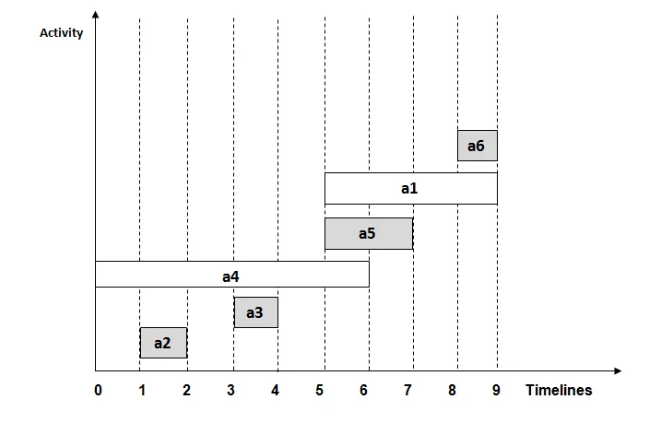
Activity Selection Problem - Example
In the below diagram, the selected activities have been highlighted in grey.

Slide 22
Activity Selection Problem
Given 10 activities along with their start and end time as
Jobs = (A1 A2 A3 A4 A5 A6 A7 A8 A9 A10)
Start time = (1,2,3,4,7,8,9,9,11,12)
Finishing time = (3,5,4,7,10,9,11,13,12,14)
Compute a schedule where the greatest number of activities takes place.
Given 6 activities with corresponding start and end time, the objective is to compute an execution schedule having maximum number of non-conflicting activities:
start[] = [1, 3, 0, 5, 8, 5]
finish[] = [2, 4, 6, 7, 9, 9]

Slide 23
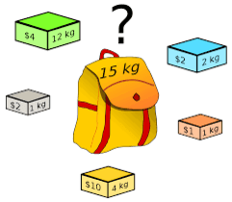
Fractional Knapsack Problem
Fractional Knapsack problem is defined as, “Given a set of items having some weight and value/profit associated with it.
The knapsack problem is to find the set of items such that the total weight is less than or equal to a given limit (size of knapsack) and the total value/profit earned is as large as possible.”

Slide 24

Fractional Knapsack Problem
We are given $n$ objects and a knapsack.
Object $i$ has a positive weight $w_{i}$and a positive value $v_{i}$ for $i = 1, 2… n.$
The knapsack can carry a weight not exceeding $W$.
Our aim is to fill the knapsack in a way that maximizes the value of the included objects, while respecting the capacity constraint.
In a fractional knapsack problem, we assume that the objects can be broken into smaller pieces.
So we may decide to carry only a fraction $x_{i}$of object $i$, where $0≤x_{i}≤1.$

Slide 25
Fractional Knapsack Problem
There are 3 Selection Functions can be defined as,
Sort the items in descending order of their values and select the items till weight criteria is satisfied.
Sort the items in ascending order of their weight and select the items till weight criteria is satisfied.
To calculate the ratio value/weight for each item and sort the item on basis of this ratio. Then take the item with the highest ratio and add it.
Note that we going use descending order of their values for solving Knapsack problem.

Slide 26
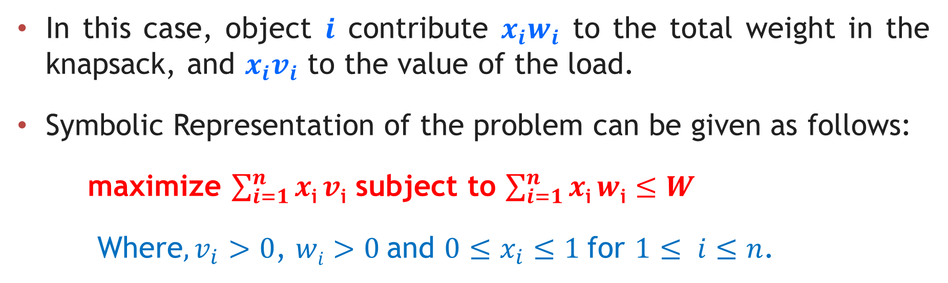
Fractional Knapsack Problem
In this case, object $i$ contribute $x_{i}w_{i}$ to the total weight in the knapsack, and $x_{i}v_{i}$ to the value of the load.
Symbolic Representation of the problem can be given as follows:
maximize $\sum_{i=1}^{n}{x\text{i}}v\text{i}$ subject to $\sum_{i=1}^{n}{x\text{i}}w\text{i}$ $≤W$
Where$, v_{i}>0$, $wi>0$and $0≤x_{i}≤1$for $1≤ i≤n$.

Slide 27

Fractional Knapsack Problem – Algorithm
Algorithm: Greedy-Fractional-Knapsack (w[1..n], p[1..n], W)
for i = 1 to n do
x[i] $←$ 0 ; weight $←$ 0
While weight < W do
i $←$ the best remaining object
if weight + w[i] ≤ W then
x[i] $←$1
weight $←$ weight + w[i]
else
x[i] $←$ (W - weight) / w[i]
weight $←$ W
return x

Slide 28
Fractional Knapsack Problem – Example1
Problem:
Consider the following instances of the fractional knapsack problem: n = 3, M = 20, V = (24, 25, 15) and W = (18, 15, 20) find the feasible solutions.
Solution:
Let us arrange items by decreasing order of profit(v_{i}). Assume that items are labelled as X = (I₁, I₂, I₃), have profit V = {24, 25, 15} and weight W = {18, 15, 20}.
Item (x_{i}) | Value (v_{i}) | Weight (w_{i}) | p_{i} = v_{i} / w_{i}
I₂ | 25 | 15 | 1.67
I₁ | 24 | 18 | 1.33
I₃ | 15 | 20 | 0.75

Slide 29
Fractional Knapsack Problem – Example1
We shall select one by one item from Table.
If the inclusion of an item does not cross the knapsack capacity, then add it. Otherwise, break the current item and select only the portion of item equivalent to remaining knapsack capacity. Select the profit accordingly.
We should stop when knapsack is full or all items are scanned.
Initialize, Weight of selected items, SW = 0,
Profit of selected items, SP = 0,
Set of selected items, S = { },
Here, Knapsack capacity M = 20.

Slide 30
Fractional Knapsack Problem – Example1
Iteration 1 :
SW= (SW + w₂) = 0 + 15 = 15
SW ≤ M, so select I₂
S = { I₂ }, SW = 15, SP = 0 + 25 = 25
Iteration 2 :
SW + w₁ > M, so break down item I_{1.}
The remaining capacity of the knapsack is 5 unit, so select only 5 units of
item I₁.
frac = (M – SW) / W[i] = (20 – 15) / 18 = 5 / 18

Slide 31
Fractional Knapsack Problem – Example1
frac = (M – SW) / W[i] = (20 – 15) / 18 = 5 / 18
S = { I_{2,} I₁ * 5/18 }
SP = SP + v₁ * frac = 25 + (24 * (5/18)) = 25 + 6.67 = 31.67
SW = SW + w₁ * frac = 15 + (18 * (5/18)) = 15 + 5 = 20
The knapsack is full. Fractional Greedy algorithm selects items { I2, I1 * 5/18 }, and it gives a profit of 31.67 units.
Note: No.of iterations will be depends on the given problem.

Slide 32

Fractional Knapsack Problem
Exercises
Find the optimal solution for knapsack problem (fraction) where knapsack capacity = 28, P = {9, 5, 2, 7, 6, 16, 3} and w = {2, 5, 6, 11, 1, 9, 1} and write down the maximum profit.
Consider Knapsack capacity $W=50$, $w = (10, 20, 40)$and $v = (60, 80,100)$find the maximum profit using greedy approach.
Consider Knapsack capacity $W = 10$, $w=(4, 8, 2, 6, 1)$and $v = (12, 32, 40, 30, 50)$. Find the maximum profit using greedy approach.

Slide 33
Job Scheduling Algorithm
Job scheduling is the problem of scheduling jobs out of a set of N jobs on a single processor which maximizes profit as much as possible.
Consider N jobs, each taking unit time for execution. Each job is having some profit and deadline associated with it. Profit earned only if the job is completed on or before its deadline. Otherwise, we have to pay a profit as a penalty.
Each job has deadline di ≥ 1 and profit pi ≥ 0. At a time, only one job can be active on the processor.

Slide 34

Job Scheduling Algorithm
We have set of $n$ jobs to execute, each of which takes unit time.
At any point of time we can execute only one job.
Job$i$earns profit $g_{i}> 0$if and only if it is executed no later than its deadline $d_{i}.$
We have to find an optimal sequence of jobs such that our total profit is maximized.
Feasible jobs: A set of job is feasible if there exits at least one sequence that allows all the jobs in the set to be executed no later than their respective deadlines.

Slide 35
Job Scheduling Algorithm
Algorithm JOB_SCHEDULING( J, D, P )
// Description : Schedule the jobs using the greedy approach which maximizes the profit
// Input :
J: Array of N jobs
D: Array of the deadline for each job
P: Array of profit associated with each job
// Output : Set of scheduled job which gives maximum profit
Sort all jobs in J in decreasing order of profit
S ← Φ // S is set of scheduled jobs, initially it is empty
SP ← 0 // Sum is the profit earned
for i ← 1 to N do
if Job J[i] is feasible then
Schedule the job in the latest possible free slot meeting its deadline.
S ← S ∪ J[i]
SP ← SP + P[i]
end
end

Slide 36
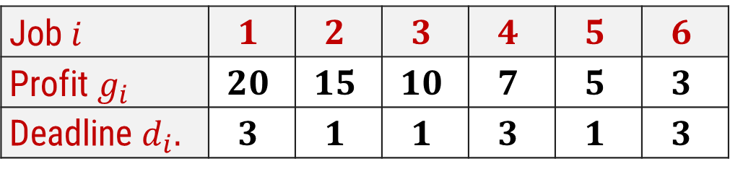

Job Scheduling Algorithm
Using greedy algorithm find an optimal schedule for following jobs with $n=6$.
Profits: $(P_{1},P_{2},P_{3},P_{4},P_{5},P_{6}) = (15,20,10,7,5,3)$&
Deadline: $(d_{1},d_{2},d_{3},d_{4},d_{5},d_{6}) = (1, 3, 1, 3, 1, 3)$
Solution:
Sort the jobs in decreasing order of their profit.
Step 1:
Job $i$ | $$1$$ | $$2$$ | $$3$$ | $$4$$ | $$5$$ | $$6$$
Profit $g_{i}$ | $$20$$ | $$15$$ | $$10$$ | $$7$$ | $$5$$ | $$3$$
Deadline $d_{i}.$ | $$3$$ | $$1$$ | $$1$$ | $$3$$ | $$1$$ | $$3$$

Slide 37
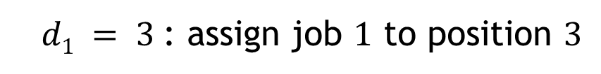
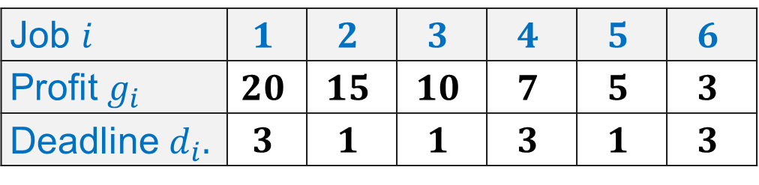
Job Scheduling Algorithm
Job $i$ | $$1$$ | $$2$$ | $$3$$ | $$4$$ | $$5$$ | $$6$$
Profit $g_{i}$ | $$20$$ | $$15$$ | $$10$$ | $$7$$ | $$5$$ | $$3$$
Deadline $d_{i}.$ | $$3$$ | $$1$$ | $$1$$ | $$3$$ | $$1$$ | $$3$$
Step 2:
Select max profit = 20 deadline = 3
P
1
2
3
Job selected
0
0
0
Step 3:
$d1 = 3$: assign job $1$ to position $3$
P
1
2
3
Job selected
0
0
J1

Slide 38
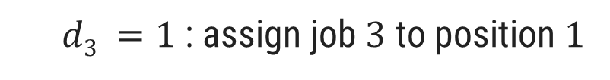
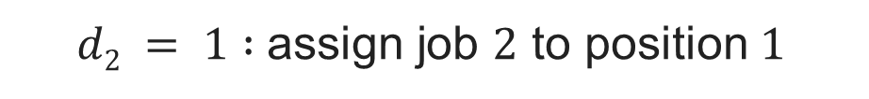
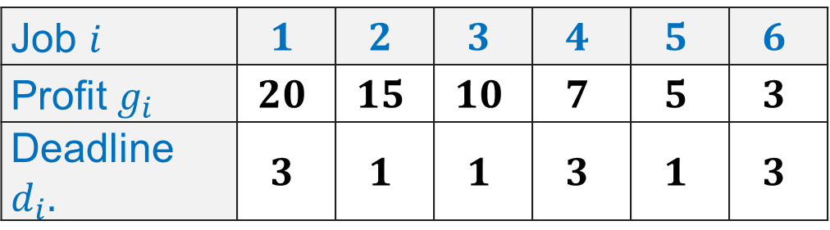
Job Scheduling Algorithm
Job $i$ | $$1$$ | $$2$$ | $$3$$ | $$4$$ | $$5$$ | $$6$$
Profit $g_{i}$ | $$20$$ | $$15$$ | $$10$$ | $$7$$ | $$5$$ | $$3$$
Deadline $d_{i}.$ | $$3$$ | $$1$$ | $$1$$ | $$3$$ | $$1$$ | $$3$$
Step 4:
$d2 = 1 :$assign job $2$ to position $1$
P
1
2
3
Job selected
J2
0
J1
Step 5:
$d3 =1$: assign job $3$ to position $1$
But position 1 is already occupied and two jobs can not be executed in parallel, so reject job 3

Slide 39
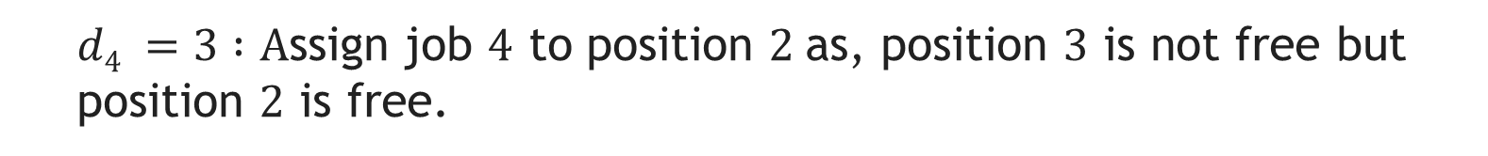
Job Scheduling Algorithm
Job $i$ | $$1$$ | $$2$$ | $$3$$ | $$4$$ | $$5$$ | $$6$$
Profit $g_{i}$ | $$20$$ | $$15$$ | $$10$$ | $$7$$ | $$5$$ | $$3$$
Deadline $d_{i}.$ | $$3$$ | $$1$$ | $$1$$ | $$3$$ | $$1$$ | $$3$$
Step 6:
$d4 =3 :A$ssign job $4$ to position $2$as, position $3$ is not free but position $2$ is free.
P
1
2
3
Job selected
J2
J4
J1
Now no more free position is left so no more jobs can be scheduled.
The final optimal sequence:
Execute the job in order 2, 4, 1 with total profit value 42.

Slide 40
Job Scheduling Algorithm
Exercises:
Using greedy algorithm find an optimal schedule for following jobs with 𝒏=4.
Profits: (a, b, c, d) = (20,10,40,30) &
Deadline: (d₁, d₂, d₃, d₄) = (4, 1, 1, 1)
Using greedy algorithm find an optimal schedule for following jobs with 𝒏=5.
Profits: (a, b, c, d, e) = (100,19,27,25,15) &
Deadline: (d₁, d₂, d₃, d₄, d₅) = (2, 1, 2, 1, 3)

Slide 41
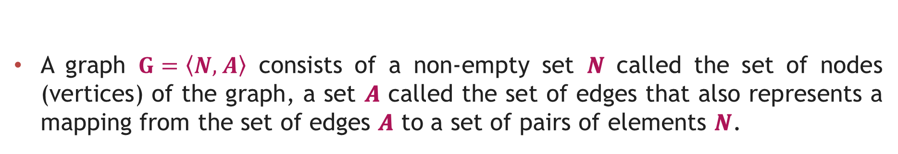
Introduction to Graph
Graph - Definition
A graph $G=\left\langle N, \right.\left.A\right\rangle$ consists of a non-empty set 𝑵 called the set of nodes (vertices) of the graph, a set 𝑨 called the set of edges that also represents a mapping from the set of edges 𝑨 to a set of pairs of elements 𝑵.
edges
(or links)
D
A
E
C
B
F
nodes
(or vertices)

Slide 42
Directed & Undirected Graph
Directed Graph: A graph in which every edge is directed from one node to another is called a directed graph or digraph.
Undirected Graph: A graph in which every edge is undirected and no direction is associated with them is called an undirected graph.
Directed Graph
Undirected Graph

Slide 43
Traversing Graph/Tree
Preorder
Visit the root.
Traverse the left sub tree in preorder.
Traverse the right sub tree in preorder.
In order
Traverse the left sub tree in in order.
Visit the root.
Traverse the right sub tree in in order.
Post order
Traverse the left sub tree in post order.
Traverse the right sub tree in post order.
Visit the root.

Slide 44
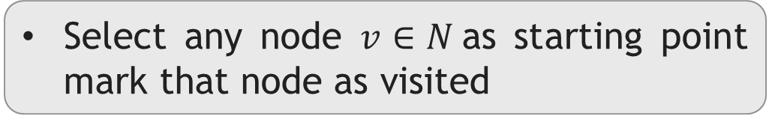
Traversing Graph/TreeDepth-First Search / Traversal
Select any node $v∈N$as starting point mark that node as visited
1
Select one of the unvisited adjacent of current node.
Make it new starting point and mark it as visited
2
3
4
5
6
7
8
If new node has no unvisited adjacent then move to parent and make it starting point
Visited :
1
2
3
6
5
4
7
8

Slide 45

DFS – Procedure
Let $G=(N, A)$be an undirected graph all of whose nodes we wish to visit.
It is somehow possible to mark a node to show it has already been visited.
To carry out a depth-first traversal of the graph, choose any node $v∈ N$as the starting point.
Mark this node to show it has been visited.
If there is a node adjacent to $v$ that has not yet been visited, choose this node as a new starting point and call the depth-first search procedure recursively.
When all the nodes adjacent to $v$ are marked, the search starting at$v$is finished.
If there remain any nodes of $G$ that have not been visited, choose any one of them as a new starting point, and call the procedure again.

Slide 46
DFS – Procedure
procedure dfsearch(G)
for each v Є N do
mark[v] ← not-visited
for each v Є N do
if mark[v] ≠ visited
then dfs(v)
procedure dfs(v)
{Node v has not previously been visited}
mark[v] ← visited
for each node w adjacent to v do
if mark[w] ≠ visited
then dfs(w)

Slide 47
Depth-First Search Algorithm
dfs(1) Initial call
dfs(2) recursive call
dfs(3) recursive call
dfs(6) recursive call
dfs(5) recursive call; progress is blocked
dfs(4) a neighbour of node 1 that has not been visited
dfs(7) recursive call
dfs(8) recursive call
There are no more nodes to visit
1
2
3
4
5
6
7
8
procedure dfs(v)
mark[v] ← visited
for each node w adjacent to v do
if mark[w] ≠ visited
then dfs(w)

Slide 48
Breadth First Search / Traversal
1
Select any node v ∈ N as starting point mark that node as visited.
2
3
4
Enqueue visited v node into queue Q
Dequeue a node from the front of queue.
Find it’s all unvisited adjacent nodes, mark as visited, enqueue into queue
5
6
7
8
1
2
3
4
5
6
7
8
Queue Q
Visited :
1
2
3
4
5
6
7
8

Slide 49
DFS – Procedure
procedure search(G)
for each v Є N do
mark[v] ← not visited
for each v Є N do
if mark[v] ≠ visited
then bfs(v)
procedure bfs(v)
Q ← empty-queue
mark[v] ← visited
enqueue v into Q
while Q is not empty do
u ← first(Q)
dequeue u from Q
for each node w adjacent to u do
if mark[w] ≠ visited
then mark[w] ← visited
enqueue w into Q

Slide 50
Comparison of DFS and BFS
Depth First Search (DFS) Breath First Search (BFS)
DFS traverses according to tree depth. DFS reaches up to the bottom of a subtree, then backtracks.
BFS traverses according to tree level. BFS finds the shortest path to the destination.
It uses a stack to keep track of the next location to visit.
It uses a queue to keep track of the next location to visit.
DFS requires less memory since only nodes on the current path are stored.
BFS guarantees that the space of possible moves is systematically examined; this search requires considerably more memory resources.
Does not guarantee to find solution. Backtracking is required if wrong path is selected.
If there is a solution, BFS is guaranteed to find it.

Slide 51
Depth First Search Breath First Search
If the selected path does not reach to the solution node, DFS gets stuck or trapped into an infinite loops.
BFS will not get trapped exploring an infinite loops.
The Time complexity of both BFS and DFS will be O(V + E), where V is the number of vertices, and E is the
number of Edges.

Slide 52

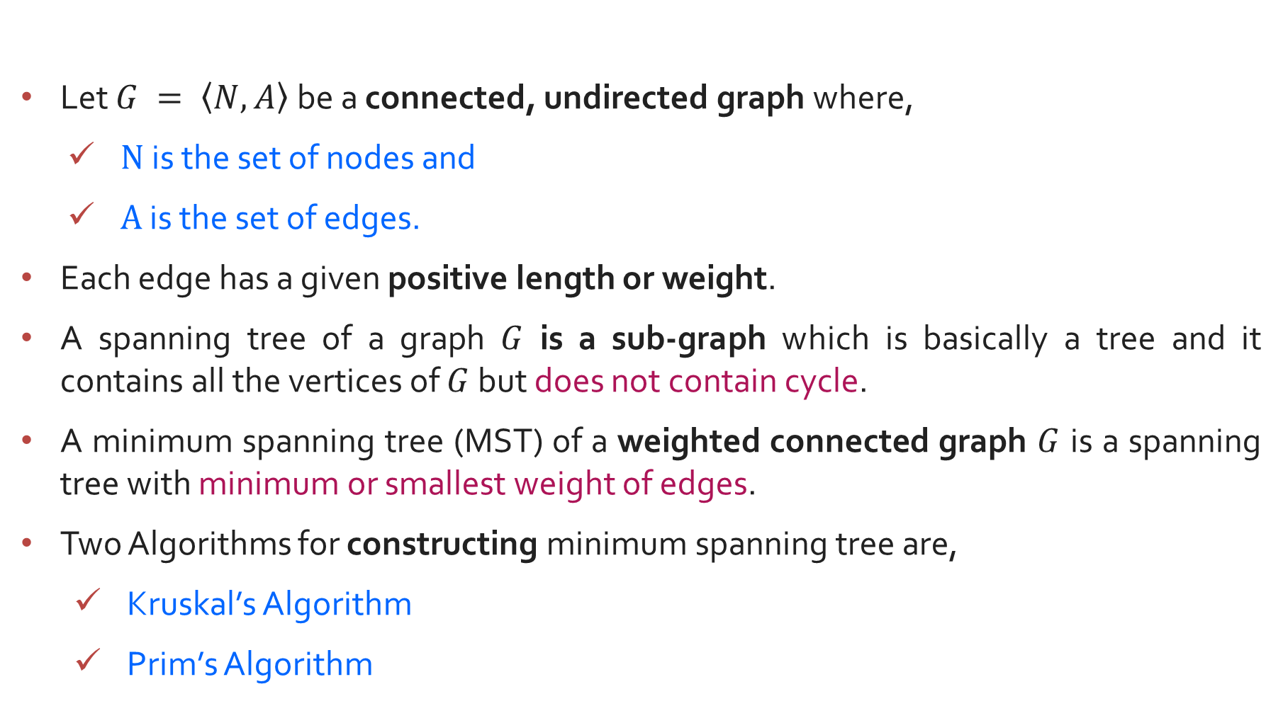
Introduction to Minimum Spanning Tree (MST)
Let $G = \left\langle N,\left.A\right\rangle \right.$be a connected, undirected graph where,
$N$ is the set of nodes and
$A$ is the set of edges.
Each edge has a given positive length or weight.
A spanning tree of a graph $G$ is a sub-graph which is basically a tree and it contains all the vertices of $G$ but does not contain cycle.
A minimum spanning tree (MST) of a weighted connected graph $G$ is a spanning tree with minimum or smallest weight of edges.
Two Algorithms for constructing minimum spanning tree are,
Kruskal’s Algorithm
Prim’s Algorithm

Slide 53
Spanning Tree Examples
Graph
A
Spanning Tree
A
B
C
B
C
D
E
F
G
D
E
F
G
H
H
Graph
Spanning Tree
A
A
B
C
E
B
C
E
D
F
D
F

Slide 54
Prim’s Algorithm
Prim's Algorithm is a greedy algorithm that is used to find the minimum spanning tree from a graph.
Prim's algorithm finds the subset of edges that includes every vertex of the graph such that the sum of the weights of the edges can be minimized.
Prim's algorithm starts with the single node and explores all the adjacent nodes with all the connecting edges at every step.
The edges with the minimal weights causing no cycles in the graph got selected.

Slide 55
Prim’s Algorithm for MST – Example 1
Step:1
Select an arbitrary node.
1
1
2
2
3
Node - Set B | Edges
1
4
6
4
5
6
4
5
6
3
8
7
4
3
7

Slide 56
Prim’s Algorithm for MST – Example 1
Step:2
Find an edge with minimum weight.
Node - Set B | Edges
1
1
1
2
2
3
{1, 2}, {1, 4}
4
6
4
5
6
1, 2
{1, 4}, {2, 3} {2, 4}, {2, 5}
1, 2, 3
{1,4}, {2,4}, {2,5}, {3,5}, {3,6}
4
5
6
3
8
1, 2, 3, 4
{2,4} {2,5} {3,5} {3,6} {4,5} {4,7}
7
4
3
{2,4} {2,5} {3,5} {3,6} {4,7} {5,6} {5,7}
1, 2, 3, 4, 5
7
1, 2, 3, 4, 5, 7
{2,4} {2,5} {3,5} {3,6} {5,6} {5,7} {6,7}
1, 2, 3, 4, 5, 6, 7

Slide 57
Prim’s Algorithm for MST – Example 1
Step:3
1
1
2
2
3
The minimum spanning tree for the given graph.
Node | Edges
1
1, 2 | {1, 2}
1, 2, 3 | {2, 3}
1, 2, 3, 4 | {1, 4}
1, 2, 3, 4, 5 | {4, 5}
1, 2, 3, 4, 5, 7 | {4, 7}
1, 2, 3, 4, 5, 6, 7 | {6, 7}
4
4
5
6
3
4
3
7
Total Cost = 17

Slide 58
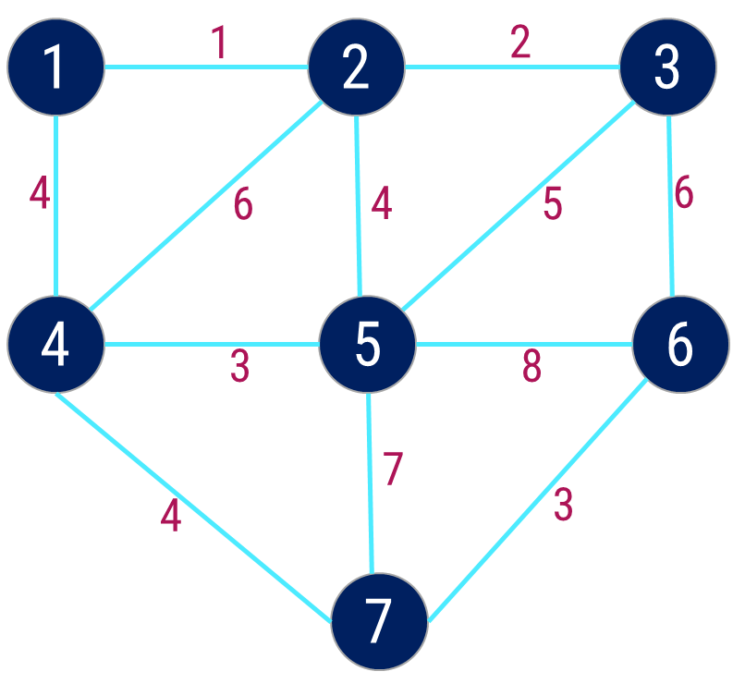
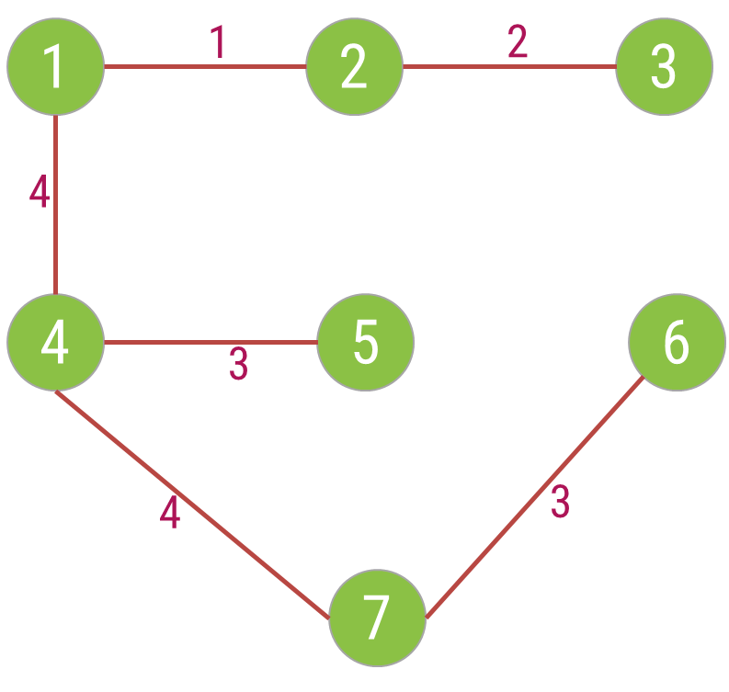
Prim’s Algorithm for MST – Example 1
Step | Edge Selected {u, v} | Set B | Edges Considered
Init. | - | {1} | --
1 | {1, 2} | {1,2} | {1,2} {1,4}
2 | {2, 3} | {1,2,3} | {1,4} {2,3} {2,4} {2,5}
3 | {1, 4} | {1,2,3,4} | {1,4} {2,4} {2,5} {3,5} {3,6}
4 | {4, 5} | {1,2,3,4,5} | {2,4} {2,5} {3,5} {3,6} {4,5} {4,7}
5 | {4, 7} | {1,2,3,4,5,7} | {2,4} {2,5} {3,5} {3,6} {4,7} {5,6} {5,7}
6 | {6,7} | {1,2,3,4,5,6,7} | {2,4} {2,5} {3,5} {3,6} {5,6} {5,7} {6,7}
Cost = 17

Slide 59

Prim’s Algorithm
Function Prim(G = (N, A): graph; length: A — R+): set of edges
T ← Ø
B ← {an arbitrary member of N}
while B ≠ N do
find e = {u, v} of minimum length such that
u $∈$ B and v ∈ N \ B
T ← T U {e}
B ← B U {v}
return T

Slide 60
Prim’s Algorithm
Applications of prim's algorithm
Prim's algorithm can be used in network designing.
It can be used to make network cycles.
It can also be used to lay down electrical wiring cables.

Slide 61


Exercises – Home Work
Write the Prim’s Algorithm to find out Minimum Spanning Tree. Apply the same and find MST for the graph given below.
$$1.$$
$$2.$$
3
A
1
10
F
C
3
A
B
C
4
4
3
7
2
4
5
8
5
B
6
D
E
F
G
4
D
H
4
2
3
2
8
1
9
3
G
E
3
H

Slide 62
Kruskal’s Algorithm for MST
Given a connected and undirected graph, a spanning tree of that graph is a subgraph that is a tree and connects all the vertices together. A single graph can have many different spanning trees.
A minimum spanning tree (MST) or minimum weight spanning tree for a weighted, connected and undirected graph is a spanning tree with weight less than or equal to the weight of every other spanning tree. The weight of a spanning tree is the sum of weights given to each edge of the spanning tree.
Below are the steps for finding MST using Kruskal’s algorithm
Sort all the edges in non-decreasing order of their weight.
Pick the smallest edge. Check if it forms a cycle with the spanning-tree formed so far. If the cycle is not formed, include this edge. Else, discard it.
Repeat step#2 until there are (V-1) edges in the spanning tree.

Slide 63
Kruskal’s Algorithm for MST – Example 1
A
Step 2: Taking next
min edge (B,C)
4
5
Step 4: Taking next
min edge (A,B)
6
6
B
E
B
3
A
4
5
7
2
2
C
D
B
E
C
D
1
3
1
2
Step 3: Taking next
min edge (B,E)
C
D
Step 1: Taking min
edge (C,D)
B
E
1
3
So, we obtained a minimum
spanning tree of cost:
4 + 2 + 1 + 3 = 10
C
D
2
1
C
D
1

Slide 64
Kruskal’s Algorithm for MST – Example 2
Step:1
Sort the edges in increasing order of their weight.
1
1
2
2
3
Edges | Weight
{1, 2} | 1
{2, 3} | 2
{4, 5} | 3
{6, 7} | 3
{1, 4} | 4
{2, 5} | 4
{4, 7} | 4
{3, 5) | 5
{2, 4} | 6
{3, 6} | 6
{5, 7} | 7
{5, 6} | 8
4
6
4
5
6
4
5
6
3
8
7
4
3
7

Slide 65
Kruskal’s Algorithm for MST – Example 2
Step:2
Select the minimum weight edge but
no cycle.
Edges | Weight
{1, 2} | 1
{2, 3} | 2
{4, 5} | 3
{6, 7} | 3
{1, 4} | 4
{2, 5} | 4
{4, 7} | 4
{3, 5) | 5
{2, 4} | 6
{3, 6} | 6
{5, 7} | 7
{5, 6} | 8
1
1
2
2
3
√
√
4
6
4
5
6
√
√
4
5
6
√
3
8
√
7
4
3
7

Slide 66
Step:3
Kruskal’s Algorithm for MST – Example 2
The minimum spanning tree for the given graph.
Edges | Weight
{1, 2} | 1
{2, 3} | 2
{4, 5} | 3
{6, 7} | 3
{1, 4} | 4
{4, 7} | 4
1
1
2
2
3
√
√
√
4
√
√
4
5
6
3
√
4
3
Total Cost = 17
7

Slide 67
Kruskal’s Algorithm – Example 2
Step | Edges considered - {u, v} | Connected Components
Init. | - | {1} {2} {3} {4} {5} {6} {7}
1 | {1,2} | {1,2} (3} {4} {5} {6} {7}
2 | {2,3} | {1,2,3} {4} {5} {6} {7}
3 | {4,5} | {1,2,3} {4,5} {6} {7}
4 | {6,7} | {1,2,3} {4,5} {6,7}
5 | {1,4} | {1,2,3,4,5} {6,7}
6 | {2,5} | Rejected
7 | {4,7} | {1,2,3,4,5,6,7}
Edges | Weight
{1, 2} | 1
{2, 3} | 2
{4, 5} | 3
{6, 7} | 3
{1, 4} | 4
{4, 7} | 4
Total Cost = 17

Slide 68
Kruskal’s Algorithm for MST
Function Kruskal(G = (N, A))
Sort A by increasing length
n ← the number of nodes in N
T ← Ø {edges of the minimum spanning tree}
Define n sets, containing a different element of set N
repeat
e ← {u, v} //e is the shortest edge not yet considered
ucomp ← find(u)
vcomp ← find(v)
if ucomp ≠ vcomp then merge(ucomp, vcomp)
T ← T U {e}
until T contains n - 1 edges
return T

Slide 69



Exercises – Home Work
The complexity for the Kruskal’s algorithm is in $θ(a log⁡n)$where $a$ is total number of edges and $n$is the total number of nodes in the graph $G$.
Write the kruskal’s Algorithm to find out Minimum Spanning Tree. Apply the same and find MST for the graph given below.
$$1.$$
$$2.$$
3
A
1
10
F
C
3
A
B
C
4
4
3
7
2
4
5
8
5
B
6
D
E
F
G
4
D
H
4
2
3
2
8
1
9
3
G
E
3
H

Slide 70

Single pair shortest path
Consider now a directed graph $G = (N, A)$where $N$ is the set of nodes and $A$ is the set of directed edges of graph $G$.
Each edge has a positive length.
One of the nodes is designated as the source node.
The problem is to determine the length of the shortest path from the source to each of the other nodes of the graph.

Slide 71
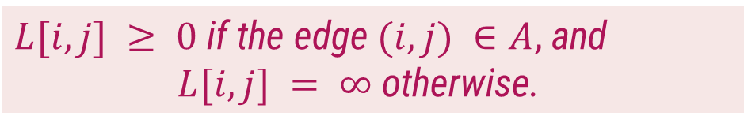
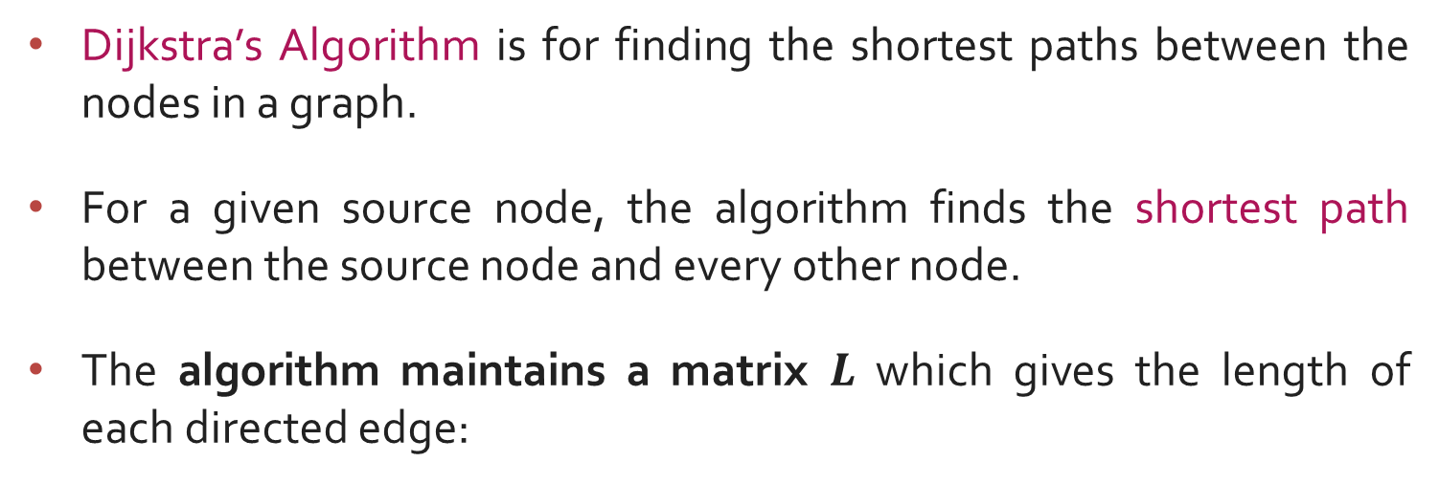
Single pair shortest path - Dijkstra’s Algorithm
Dijkstra’s Algorithm is for finding the shortest paths between the nodes in a graph.
For a given source node, the algorithm finds the shortest path between the source node and every other node.
The algorithm maintains a matrix $L$ which gives the length of each directed edge:
$L[i, j] ≥ 0$ if the edge $(i, j) ∈A,$and
$L[i, j] = ∞$otherwise.

Slide 72

Single pair shortest path - Dijkstra’s Algorithm
Function Dijkstra(L[1 .. n, 1 .. n]): array [2..n]
array D[2.. n]
C $←$ {2,3,…, n}
{S = N \ C exists only implicitly}
for i $←$ 2 to n do
D[i] $←$ L[1, i]
repeat n - 2 times
v $←$ some element of C minimizing D[v]
C $←$ C \ {v} {and implicitly S $←$ S U {v}}
for each w $∈$ C do
D[w] $←$ min(D[w], D[v] + L[v, w])
return D

Slide 73
How Dijkstra’s algorithm Work?
The algorithm works by maintaining a set of vertices that have already been visited, and a set of vertices that have not yet been visited.
The algorithm starts at the source vertex and adds it to the set of visited vertices.
Then, it repeatedly finds the vertex in the set of unvisited vertices that has the shortest known path to the source vertex, and adds that vertex to the set of visited vertices.
This process continues until all vertices have been visited.

Slide 74
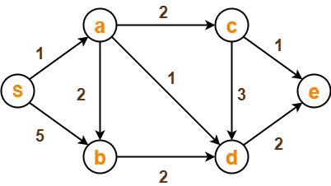
Dijkstra’s Algorithm - Example
Problem:
Using Dijkstra’s Algorithm, find the shortest distance from source vertex ‘S’ to remaining vertices in the following graph

Slide 75
Dijkstra’s Algorithm - Example
Solution:
Step 1: The following two sets are created,
Unvisited set : {S , a , b , c , d , e}
Visited set : { }

Slide 76
Dijkstra’s Algorithm - Example

Slide 77
Dijkstra’s Algorithm - Example

Slide 78
Dijkstra’s Algorithm - Example

Slide 79
Dijkstra’s Algorithm - Example

Slide 80
Dijkstra’s Algorithm - Example
1
Single source shortest path algorithm
10
50
5
2
100
30
Source node = 1
10
5
Step
v
C
2
3
4
5
20
Init.
-
{2, 3, 4, 5}
50
30
100
10
4
3
50
1
5
{2, 3, 4}
50
30
20
10
Is there path from 1 - 5 - 2
No
Compare cost of 1–5–4 (20) and 1–4 (100)
Is there path from 1 - 5 - 4
Is there path from 1 - 5 - 3
Yes

Slide 81
Dijkstra’s Algorithm - Example
1
Single source shortest path algorithm
10
50
5
2
100
30
Source node = 1
Dijkstra’s Algorithm - Example
10
5
Step
v
C
2
3
4
5
20
Init.
-
{2, 3, 4, 5}
50
30
100
10
4
3
50
1
5
{2, 3, 4}
50
30
20
10
2
4
{2, 3}
40
30
20
10
Is there path from 1 - 4 - 2
Yes
Compare cost of 1–4–2 (40) and 1–2(50)
Compare cost of 1–4–3 (70) and 1–3 (30)
Is there path from 1 - 4 - 5
No
Is there path from 1 - 4 - 3

Slide 82
Dijkstra’s Algorithm - Example
1
Single source shortest path algorithm
10
50
5
2
100
30
Source node = 1
10
5
Step
v
C
2
3
4
5
20
Init.
-
{2, 3, 4, 5}
50
30
100
10
4
3
50
1
5
{2, 3, 4}
50
30
20
10
2
4
{2, 3}
40
30
20
10
3
3
{2}
35
30
20
10
Is there path from 1 - 3 - 2
Yes
Compare cost of 1–3–2 and 1–2
Is there path from 1 - 3 - 4
No
Is there path from 1 - 3 - 5

Slide 83


Dijkstra’s Algorithm - Example
Exercises:
Write Dijkstra’s Algorithm for shortest path. Use the algorithm to find the shortest path from the following graph.
$$1.$$
$$2.$$
A
2
B
B
2
D
10
4
1
3
10
A
1
4
8
7
9
C
2
D
2
E
3
2
5
8
4
6
C
E
F
1
G

Slide 84

All Points Shortest path using Dynamic Programming
Given a directed, connected weighted graph $G(V, E),$for each edge $⟨u, v⟩∈E$, a weight $w(u, v)$is associated with each edge.
The all pairs of shortest paths problem is to find a shortest path from $u$ to $v$ for every pair of vertices $u$ and $v$ in $V$.
Floyd’s algorithm is used to find all pair shortest path problem from a given weighted graph.
As a result of this algorithm, it will generate a matrix, which will represent the minimum distance from any node to all other nodes in the graph.
At first, the output matrix is same as given cost matrix of the graph.
As the algorithm proceeds, the output matrix will be updated with each vertex $k$ as an intermediate vertex.
The time complexity of this algorithm is $O(n^{3})$, where $n$ is the number of vertices in the graph.

Slide 85
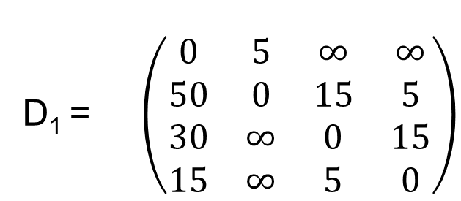
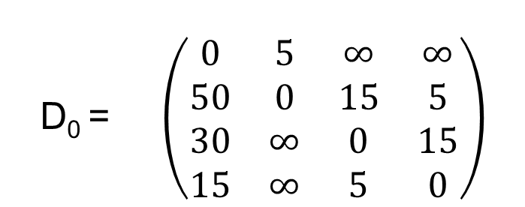
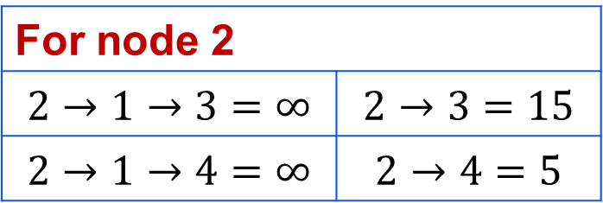
Floyd Algorithm - Example
Step: 2
Calculate the distance between each node with node 1 as an intermediate node.
1
15
4
30
5
5
50
5
15
1 | 2 | 3 | 4
D₁ = $\left(\begin{matrix}0 & 5 & ∞ & ∞ \\ 50 & 0 & 15 & 5 \\ 30 & ∞ & 0 & 15 \\ 15 & ∞ & 5 & 0\end{matrix}\right)$
2
3
1
2
3
4
15
Step: 1
Initialization
1 | 2 | 3 | 4
D₀ = $\left(\begin{matrix}0 & 5 & ∞ & ∞ \\ 50 & 0 & 15 & 5 \\ 30 & ∞ & 0 & 15 \\ 15 & ∞ & 5 & 0\end{matrix}\right)$
For node 2
$$2→1→3=∞$$ | $$2→3=15$$
$$2→1→4=∞$$ | $$2→4=5$$
1
2
3
4
No change

Slide 86

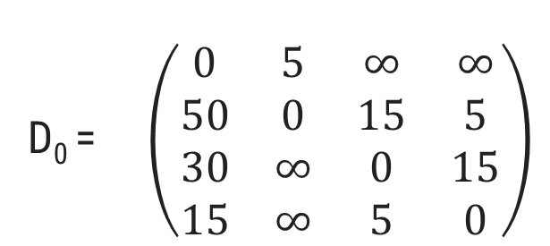

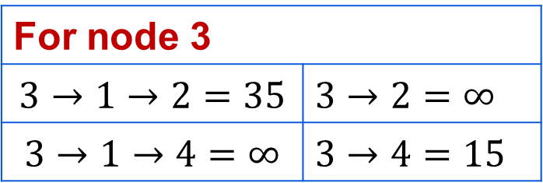
Floyd Algorithm - Example
Step: 2
Calculate the distance between each node with node 1 as an intermediate node.
1
15
4
30
5
5
50
5
15
1 | 2 | 3 | 4
D₁ = $\left(\begin{matrix}0 & 5 & ∞ & ∞ \\ 50 & 0 & 15 & 5 \\ 30 & ∞ & 0 & 15 \\ 15 & ∞ & 5 & 0\end{matrix}\right)$
2
3
1
2
3
4
15
$$35$$
Step: 1
Initialization
1 | 2 | 3 | 4
D₀ = $\left(\begin{matrix}0 & 5 & ∞ & ∞ \\ 50 & 0 & 15 & 5 \\ 30 & ∞ & 0 & 15 \\ 15 & ∞ & 5 & 0\end{matrix}\right)$
1
2
3
4
For node 3
$$3→1→2=35$$ | $$3→2=∞$$
$$3→1→4=∞$$ | $$3→4=15$$

Slide 87


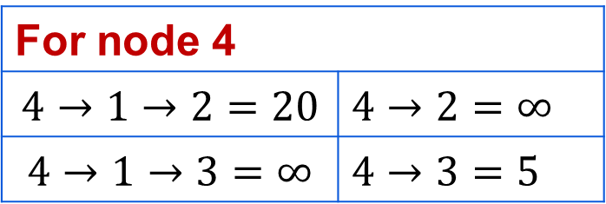
Floyd Algorithm - Example
Step: 2
Calculate the distance between each node with node 1 as an intermediate node.
1
15
4
30
5
5
50
5
15
1 | 2 | 3 | 4
D₁ = $\left(\begin{matrix}0 & 5 & ∞ & ∞ \\ 50 & 0 & 15 & 5 \\ 30 & 35 & 0 & 15 \\ 15 & ∞ & 5 & 0\end{matrix}\right)$
2
3
1
2
3
4
15
Step: 1
Initialization
$$20$$
1 | 2 | 3 | 4
D₀ = $\left(\begin{matrix}0 & 5 & ∞ & ∞ \\ 50 & 0 & 15 & 5 \\ 30 & ∞ & 0 & 15 \\ 15 & ∞ & 5 & 0\end{matrix}\right)$
1
2
3
4
For node 4
$$4→1→2=20$$ | $$4→2=∞$$
$$4→1→3=∞$$ | $$4→3=5$$

Slide 88



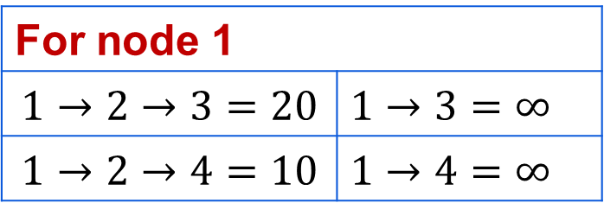
Floyd Algorithm - Example
Step: 3
Calculate the distance between each node with node 2 as an intermediate node.
1
15
4
30
5
5
50
5
15
1 | 2 | 3 | 4
D₂ = $\left(\begin{matrix}0 & 5 & ∞ & ∞ \\ 50 & 0 & 15 & 5 \\ 30 & 35 & 0 & 15 \\ 15 & 20 & 5 & 0\end{matrix}\right)$
1
2
3
4
$$20$$
$$10$$
2
3
15
Step: 1
Initialization
1 | 2 | 3 | 4
D₀ = $\left(\begin{matrix}0 & 5 & ∞ & ∞ \\ 50 & 0 & 15 & 5 \\ 30 & ∞ & 0 & 15 \\ 15 & ∞ & 5 & 0\end{matrix}\right)$
1
2
3
4
For node 1
$$1→2→3=20$$ | $$1→3=∞$$
$$1→2→4=10$$ | $$1→4=∞$$
No change for Node 3 & 4

Slide 89


Floyd Algorithm - Example
Step: 4
Calculate the distance between each node with node 3 as an intermediate node.
1
15
4
30
5
5
50
5
15
1 | 2 | 3 | 4
D₃ = $\left(\begin{matrix}0 & 5 & 20 & 10 \\ 50 & 0 & 15 & 5 \\ 30 & 35 & 0 & 15 \\ 15 & 20 & 5 & 0\end{matrix}\right)$
2
3
1
2
3
4
15
Step: 1
Initialization
1 | 2 | 3 | 4
D₀ = $\left(\begin{matrix}0 & 5 & ∞ & ∞ \\ 50 & 0 & 15 & 5 \\ 30 & ∞ & 0 & 15 \\ 15 & ∞ & 5 & 0\end{matrix}\right)$
1
2
3
4
For node 1
$$1→3→2=55$$ | $$1→2=5$$
$$1→3→4=35$$ | $$1→4=10$$
No change

Slide 90

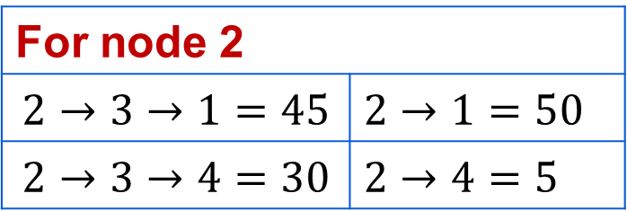
Floyd Algorithm - Example
Step: 4
Calculate the distance between each node with node 3 as an intermediate node.
1
15
4
30
5
5
50
5
15
1 | 2 | 3 | 4
D₃ = $\left(\begin{matrix}0 & 5 & 20 & 10 \\ 50 & 0 & 15 & 5 \\ 30 & 35 & 0 & 15 \\ 15 & 20 & 5 & 0\end{matrix}\right)$
2
3
1
2
3
4
15
$$45$$
Step: 1
Initialization
1 | 2 | 3 | 4
D₀ = $\left(\begin{matrix}0 & 5 & ∞ & ∞ \\ 50 & 0 & 15 & 5 \\ 30 & ∞ & 0 & 15 \\ 15 & ∞ & 5 & 0\end{matrix}\right)$
1
2
3
4
For node 2
$$2→3→1=45$$ | $$2→1=50$$
$$2→3→4=30$$ | $$2→4=5$$
No change for Node 4

Slide 91



Floyd Algorithm - Example
Step: 5
Calculate the distance between each node with node 4 as an intermediate node.
1
15
4
30
5
5
50
5
15
1 | 2 | 3 | 4
D₄ = $\left(\begin{matrix}0 & 5 & 20 & 10 \\ 45 & 0 & 15 & 5 \\ 30 & 35 & 0 & 15 \\ 15 & 20 & 5 & 0\end{matrix}\right)$
2
3
1
2
3
4
$$15$$
15
Step: 1
Initialization
1 | 2 | 3 | 4
D₀ = $\left(\begin{matrix}0 & 5 & ∞ & ∞ \\ 50 & 0 & 15 & 5 \\ 30 & ∞ & 0 & 15 \\ 15 & ∞ & 5 & 0\end{matrix}\right)$
1
2
3
4
For node 1
$$1→4→2=30$$ | $$1→2=5$$
$$1→4→3=15$$ | $$1→3=20$$

Slide 92




Floyd Algorithm - Example
Step: 5
Calculate the distance between each node with node 4 as an intermediate node.
1
15
4
30
5
5
50
5
15
1 | 2 | 3 | 4
D₄ = $\left(\begin{matrix}0 & 5 & 15 & 10 \\ 45 & 0 & 15 & 5 \\ 30 & 35 & 0 & 15 \\ 15 & 20 & 5 & 0\end{matrix}\right)$
2
3
1
2
3
4
15
$$20$$
$$10$$
Step: 1
Initialization
1 | 2 | 3 | 4
D₀ = $\left(\begin{matrix}0 & 5 & ∞ & ∞ \\ 50 & 0 & 15 & 5 \\ 30 & ∞ & 0 & 15 \\ 15 & ∞ & 5 & 0\end{matrix}\right)$
1
2
3
4
For node 2
$$2→4→1=20$$ | $$2→1=45$$
$$2→4→3=10$$ | $$2→3=15$$
No change for Node 3

Slide 93

Floyd Algorithm - Example
Step: 5
Calculate the distance between each node with node 4 as an intermediate node.
1
15
4
30
5
5
50
5
15
1 | 2 | 3 | 4
D₄ = $\left(\begin{matrix}0 & 5 & 15 & 10 \\ 20 & 0 & 10 & 5 \\ 30 & 35 & 0 & 15 \\ 15 & 20 & 5 & 0\end{matrix}\right)$
2
3
1
2
3
4
15
Step: 1
Initialization
1 | 2 | 3 | 4
D₀ = $\left(\begin{matrix}0 & 5 & ∞ & ∞ \\ 50 & 0 & 15 & 5 \\ 30 & ∞ & 0 & 15 \\ 15 & ∞ & 5 & 0\end{matrix}\right)$
1
2
3
4
Final Solution

Slide 94
Floyd’s Algorithm
function Floyd(L[1..n, 1..n]):array [1..n, 1..n]
array D[1..n, 1..n]
D ← L
for k ← 1 to n do
for i ← 1 to n do
for j ← 1 to n do
D[i,j] ← min(D[i,j], D[i,k]+ D[k,j])
return D

Slide 95
Thank you!!

